Slide 1
ALL 2 Presentation Slide
Lim Ni Feih, Ota Kazuki

Slide 2
Problem Statement
Users do not realize how much money they spend which can lead
to ending up in a lot of debts despite having stable income.
People with busy lives sometimes forget their credit payment due dates
Many people who are not able to manage their money accurately
even using the money management apps.

Slide 3
Research Question
How can people make sure they do not overspend their money?
How do people make sure that they pay their due credits on
time despite their busy schedule?
How can people plan their budget better while using a money management application?

Slide 4
ObJective
To develop a desktop money management application that allows
users to track and plan their expenses easily.
To develop a notification feature for credit due dates so that
users do not receive a penalty for paying their due credits late to banks.
To develop a feature that gives tips and advises users on how
to better manage their money.

Slide 5
LITERATURE REVIEW
Financial Problem In Malaysia

Slide 6
LITERATURE REVIEW
Programing Language
GUI Software
Python
C++
Java
Ruby
PHP
Tkinter
PyQt
kivy
wxPython
Libavg

Slide 7
LITERATURE REVIEW
Methodology
Existing System
Waterfall
Agile
Lean Development
Iteretive Development
Spiral Development
Mint
LessAccounting
Quicken
Itemize
TrackMySubs

Slide 8
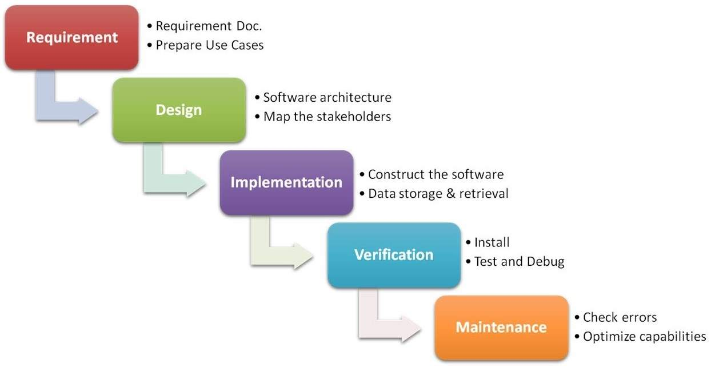
Methodology (Waterfall Model)

Slide 9
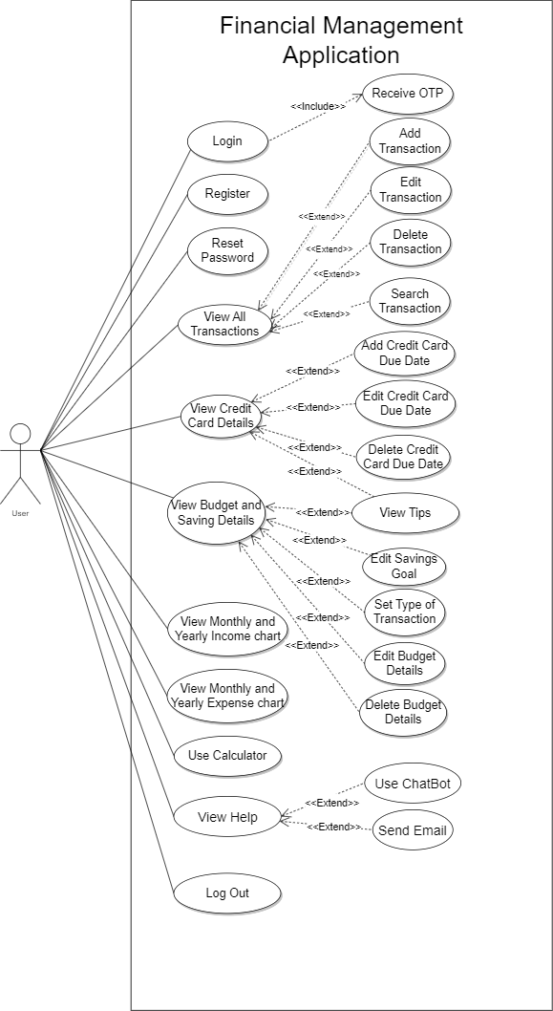
Use Case Diagram

Slide 10
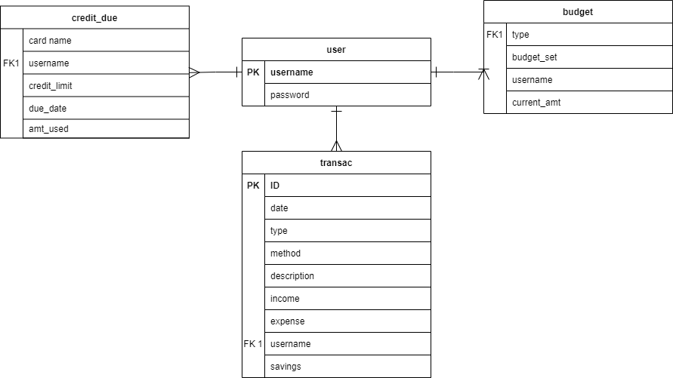
ER Diagram

Slide 11
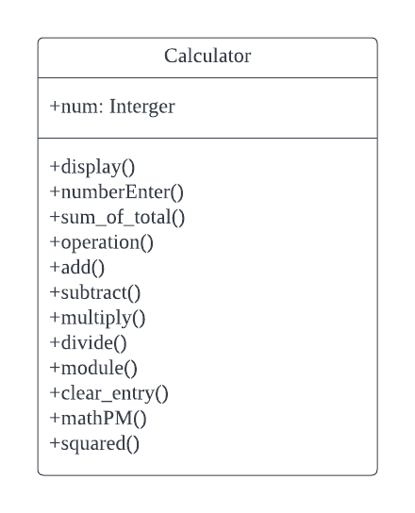
Class Diagram

Slide 12
Additional Features In Our System
Credit Card Due reminder
Chatbot
Send Email To User/Developer

Slide 13
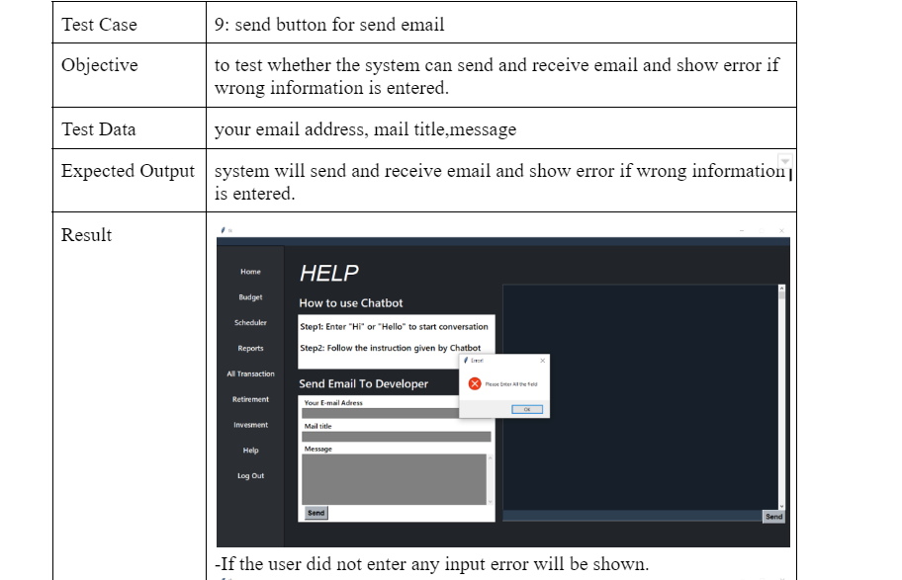
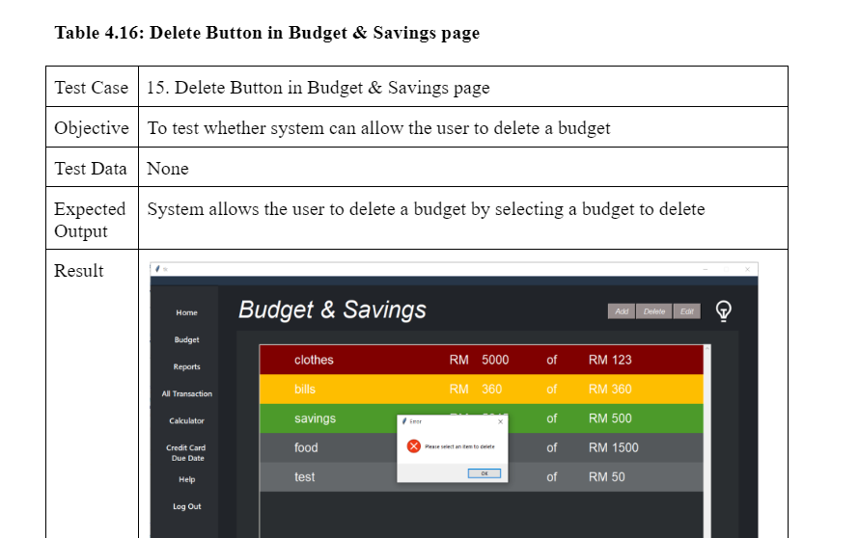
Testing

Slide 14
DEMO

Slide 15
Future Enhancement
Collaborate with banks so user do not have to manually
key in transactions
Strengthen the security system by including Captcha
Include expense charts based on Budget type
Send notifications to user’s email for credit card due date

Slide 16
THANK YOU!

